Slide 1

Quant Week 5
3/14/24
Notes:
Complete

Slide 2

Agenda
Icebreaker Question
Brainteasers
Greek Options Values
Project

Slide 3
Ice Breaker
Favorite flavor (of anything)

Slide 4


IMC Sponsorship!
Referal Code: 3MRLW8

Slide 5
IMC Sponsorship!
Sophomores, apply to IMC Launchpad:
https://careers.imc.com/us/en/launchpad
Great opportunity to learn
If you get in, IMC gives you a final round internship interview
IMC Event
Time/Date TBD

Slide 6
Brain Teaser - Bankers
2 bankers arrive at the station at some random time between 5 and 6am.
(uniform distribution)
They stay exactly 5 minutes then leave.
On a given day, what is the probability they will run into each other?

Slide 7
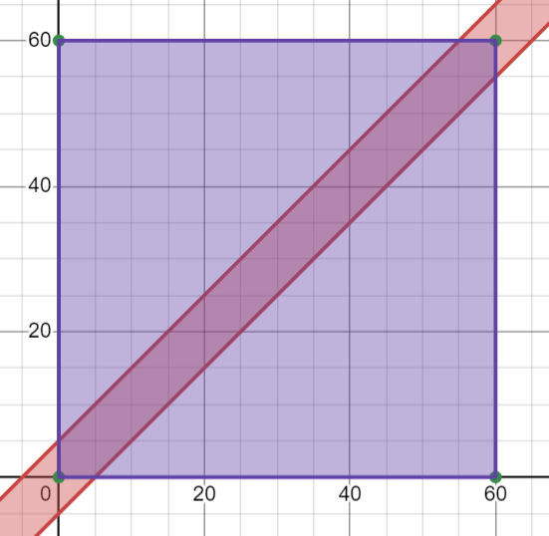
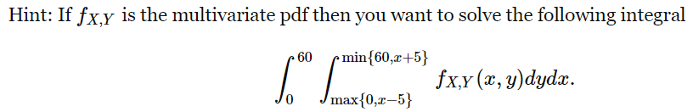
Brain Teaser - Bankers - Solution
Let’s say these people are person X and person Y. Their arrival times are each between 0 and 60.
They will meet when |X - Y| ≤ 5
Find the area of the red strip
(60*60 - 2*(½*55*55)) / 3600
= 23/144
Technical formulaic way of thinking about this problem: where f=1/3600

Slide 8
Option Greek Values

Slide 9
What are the Greeks?
The Greek values are metrics that are used to determine the performance of options in relation to their underlying asset.
These are the first partial derivatives of various factors influencing the asset value.
The primary greek values are:
Delta Δ, Theta Θ, Gamma Γ, Vega v, and Rho ⍴
Note: Alpha and Beta are not included here.

Slide 10
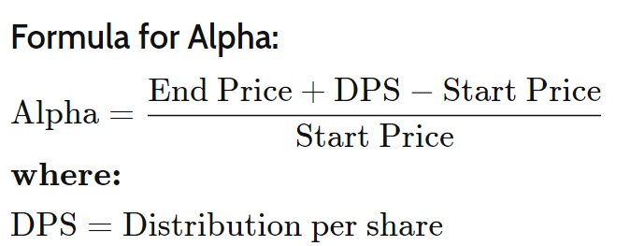
Alpha (not a Greek)
This measures how good/bad a stock has performed compared to a benchmark
Often measured in percentage
Example:
Stock Starting Price: $20
Stock Ending Price: $21
Dividend: $1
Alpha = (21 + 1 - 20) / 20 = 10%
From Investopedia:

Slide 11
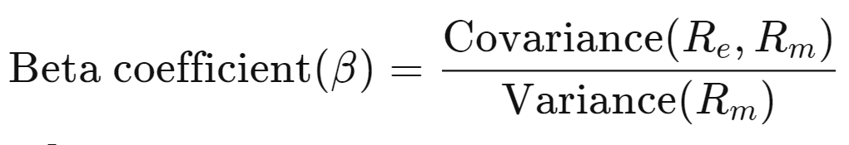
Beta β (not a Greek)
Even though Beta is a greek letter, it is not considered a greek.
It doesn’t represent a partial derivative of the underlying asset like the other values do.
Beta represents the volatility of an asset compared to the rest of the market.
In terms of statistics, this is very similar to variance but is normalized to the market as a whole
A beta of greater than 1 means the asset is more volatile than the market
A beta of less than 1 means the asset is less volatile than the market

Slide 12
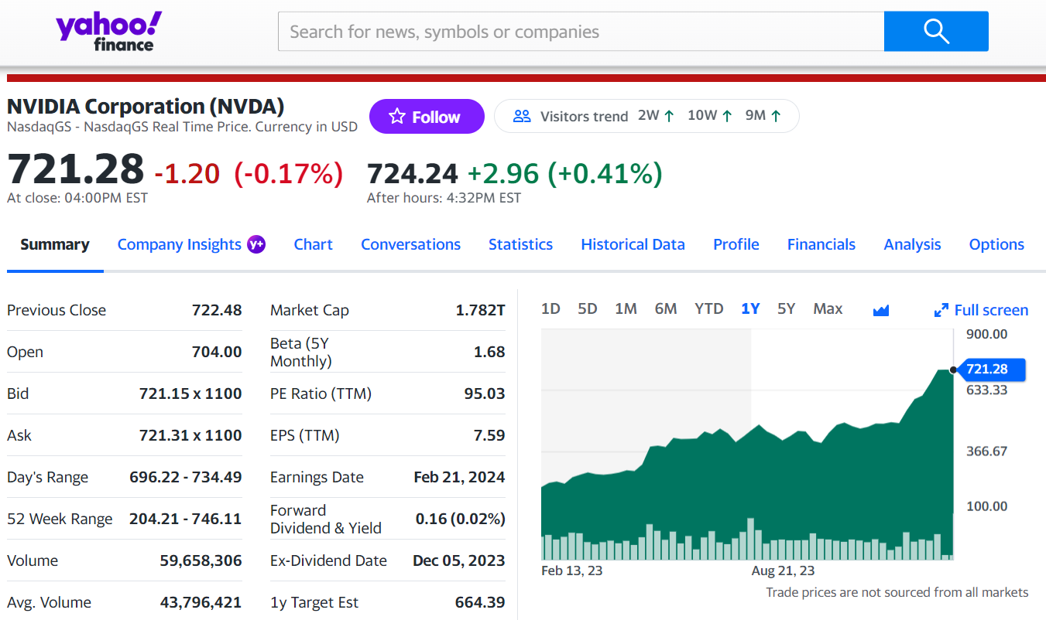
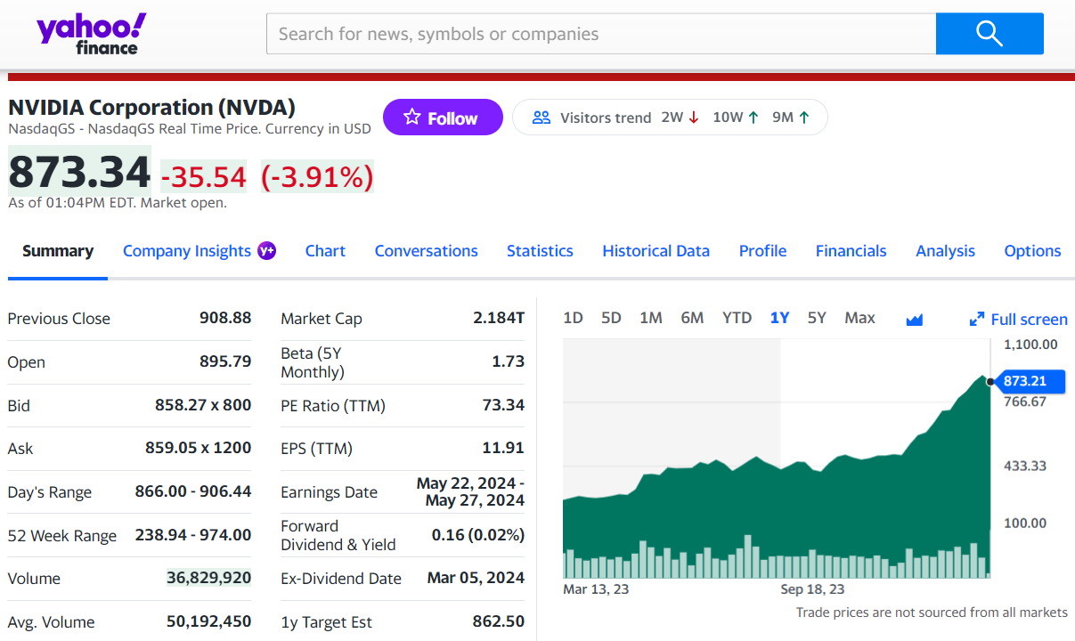
Look at NVDA (again)

Slide 13
Delta Δ
Estimates the change in price of the derivative/option based on a $1 move in the price of the underlying asset
This value is typically not above 1.0
Example,
A stock price increases by $2.
A call option with a strike price of $80 that is currently trading at $20 has a delta of 0.8 What will the new price of this be?
$21.60

Slide 14
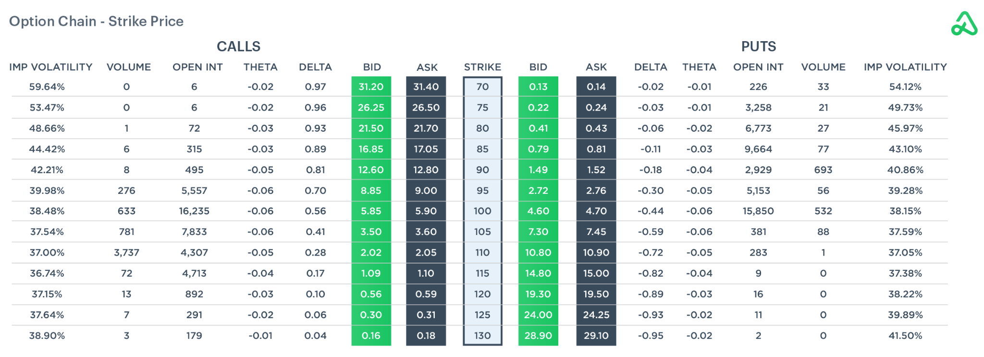

Slide 15
Theta Θ
Estimates the rate of change between price and time
Value will get larger as the option gets closer to date of expiration
In-the-money options will have a positive theta value, out of the money options will be negative
Example,
A theta value is -0.5
This means that for every day that passes, the price of the option will go down by $0.50

Slide 16
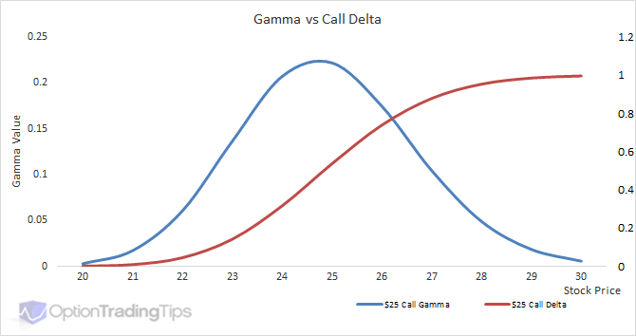
Gamma Γ
The derivative of Delta with respect to price
Basically how fast the Delta is changing at a price
Higher gamma values mean more risk. Given 2 stocks with equal delta values that each have price changes of $5, the one with a higher gamma will have a larger change in price

Slide 17
Vega v
Measures change in price based on change in implied volatility.
Forward-looking
Whereas delta measures in terms of actual price change, Vega measures in terms of theoretical price changes

Slide 18
Rho ⍴
Measures Price change in terms of Interest Rates

Slide 19
Other Lesser Known Greeks
Lambda, Epsilon, Vomma, Vera, Zomma, and Ultima
These are second and third derivatives of the other greeks we have talked about
These trends can also be seen by those with a keen eye by looking at the main Greeks, but are explicitly calculated and named to be these variables
Becoming increasingly more important in large algorithms because they are relatively easy to compute and can show hidden patterns

Slide 20
Project Discussion/Work Time
Notes:
Idea:
We’ll write the platform to make and conduct trading strategies.
You guys will write and implement the strategies, test them on prior data
Alternate for more software-oriented people you guys could also make the platform
We can do this in python/C++, if python use numPy and Yahoo Finance data
Use matplotlib plot graphs, show that in pdf/md/html file through github

Slide 21
Current Environment
As of right now, we’ll use Google Drive/Colab
.py files stored in the drive, need to be implemented
.ipynb file for driver, also needs to be implemented
Hoping to move to git/github and conda environments soon
Review the guide and setup your python and conda environments accordingly
If you get stuck, I will be available to help out next week outside of our normal meeting

Slide 22
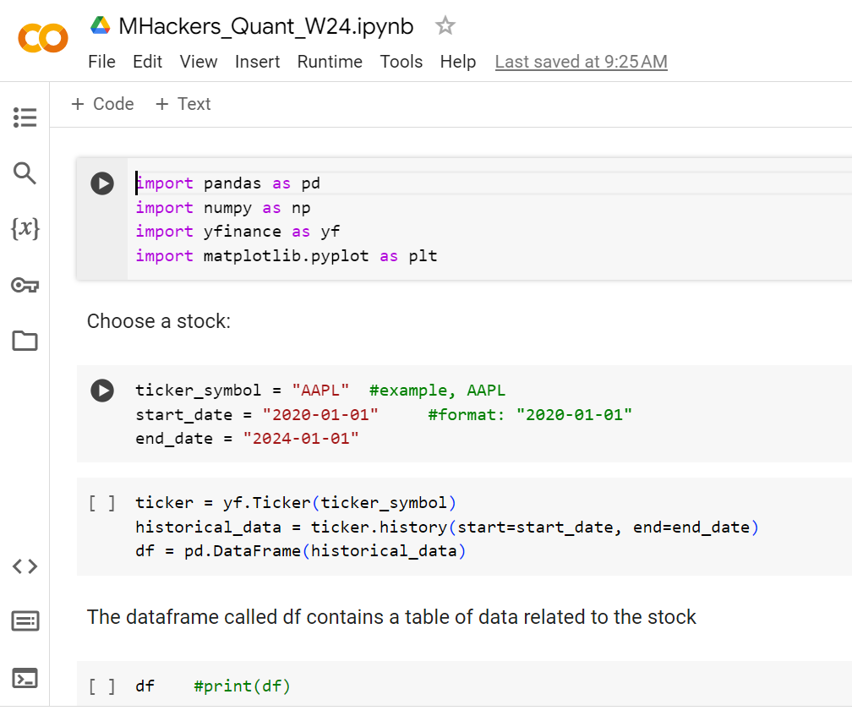
Google Colab
Located in Quant Drive
Copy this and put it in your drive
Sample finance
commands/functions,
What we’ve been working on

Slide 23
algorithm.py
Base class for algorithms
Other algorithms we develop will inherit from this
Necessary to standardize input/output so we can backtest many types of algos
Member variables
portfolio: dictionary of (Ticker, # of shares)
cash: amount of cash on hand (can be negative)
Member functions:
buy(Ticker): increases ticker value, decreases cash
sell(Ticker): decreases ticker value, increases cash

Slide 24
backtest.py
Backtest class contains functions for running algorithms
run(algorithm, startDate, endDate): runs the algorithm on a particular date range
Logs relevant information, like when trades are made, portfolio value at each time step
graphReturns(): creates a plot of returns vs. time (using matplotlib)
calculateVol(): calculates the volatility of the algorithm
calculateSharpe(): calculates the Sharpe ratio of the algorithm (risk v. return)

Slide 25
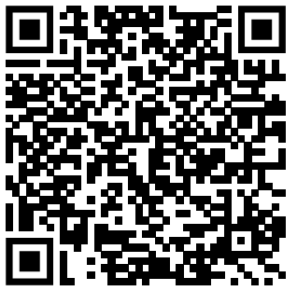
Attendance Form
This one
Link to Onboarding Document, Slack and Team Folder
https://docs.google.com/document/d/1oA2q-qjPCw1bY79zWf1LtpeN_da65L0ntnxzCQSsJRc/edit?usp=sharing

